Slide 1
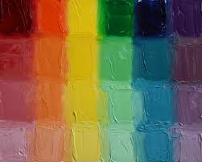
Color
Notes:
Backround info for docents (don’t need to read out loud)
Color and Color Theory
Hue is the main component of the color. In light it is the frequency; in paint, the pigment. It is the pure, unmixed color from a tube or from a ray of light.
Saturation is how much of a hue is in a color, also called Chroma.
Value is how light or dark a color is. Value is usually used to describe form, with changes in value reflecting the changes in form.
In visual art, color is the only thing that is actually seen. We don't actually see objects; we see the light reflected off of the objects. Color is part of the electromagnetic spectrum. Photons emitted from electrons moving up or down levels in the rings of an atom are the substance of color. Differences in color that define a shape are called value, and some people wrongly call this an element; value is merely the color changes along a form.
Color Theory is simple a system to describe and organize colors.
Color Wheel - A circular, logical organization of colors. The most common color wheel starts with Red, then moves to Orange, Yellow, Green, Cyan, Blue, Purple, and ends with Red-Violet. Color wheels are the basis for most color theories.
Primary Colors on a color wheel are the fundamental, unmixable colors. In paint they are Red, Yellow, and Blue.
Secondary Colors are the result of mixing equal parts of two primary colors together). In paint they are Orange, Green, and Purple or Violet.
Tertiary Colors are the result of mixing equal parts of neighboring primary and secondary colors together.
A Monochromatic Color Scheme is one color and all the tints, tones, shades, and chromas of that color.

Slide 2
Elements of Art
The language of art, vocabulary, and visual symbols used to create works of art. These basic elements include: line, shape, form, texture, color, and space.
Notes:
Today we are discussing color.

Slide 3
Properties of Color
Value describes the lightness or darkness of a hue.
Hue refers to a pure color (without adding black or white).
Intensity is the brightness or dullness of a color

Slide 4
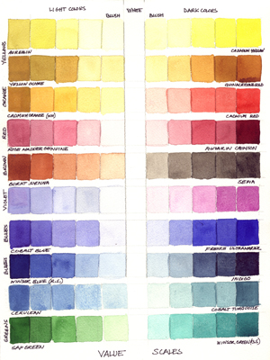
Value: A light color is high in value, or closer to white. A dark color, is low in value, or closer to black.

Slide 5
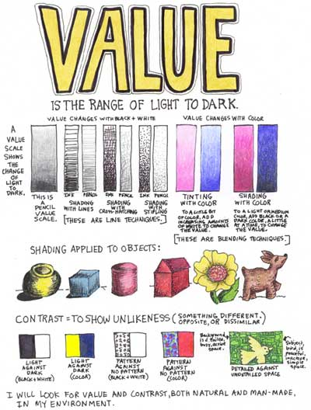

Slide 6
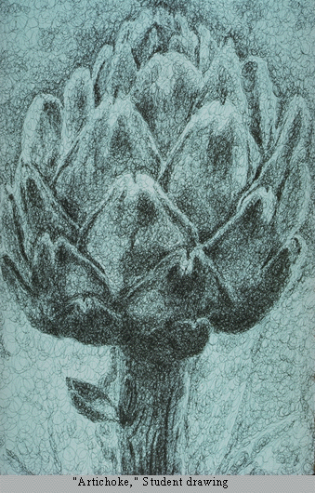
Value contrast
Separates the artichoke from the background and the leaves from one another
Notes:
VALUE is an important tool for artists; it allows artists to define form and create spatial illusions.
In the drawing, value contrast separates the artichoke from the background, and the separate leaves from one another. Value gradation creates the illusion of contour – it suggests the curves of leave surfaces and of the whole form.

Slide 7
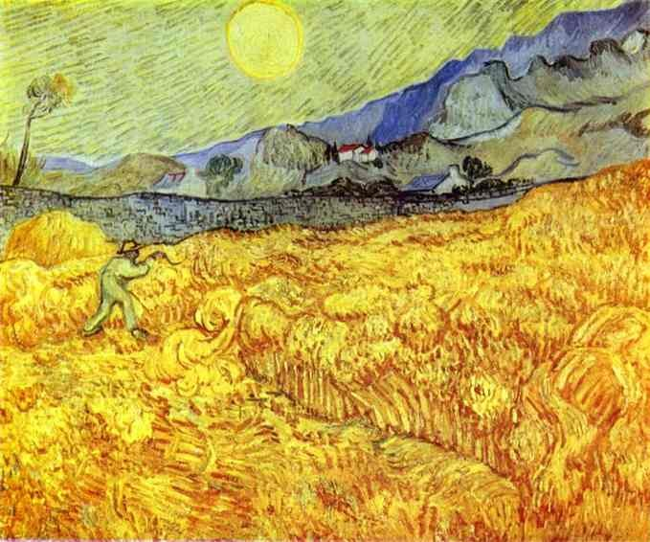
Understanding the color value allows an artist to use a range of light and dark hues (colors) to make their art work more interesting.
Landscape by Vincent Van Gogh

Slide 8
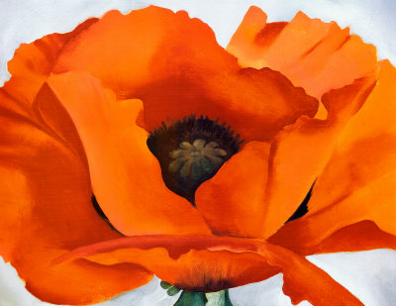
Georgia O’Keeffe
Red Poppy
Notes:
Notice the use of VALUE CONTRAST to show the individual petals of the poppy

Slide 9
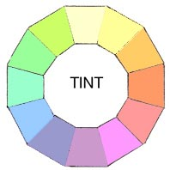
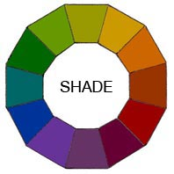
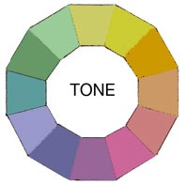
Colors can be altered in three ways by Tinting, Shading or Toning. And that's before we even think about mixing two colors together.
Tints
A Tint is simply any color with white added.
It is sometimes called a Pastel.
Shades
A Shade is simply any color with black added.
Tones
A Tone is created by adding both White and Black which is grey. Any color that is "greyed down" is considered a Tone.

Slide 10
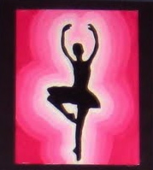
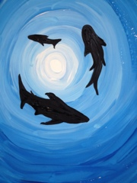
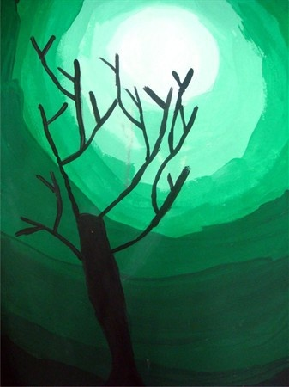
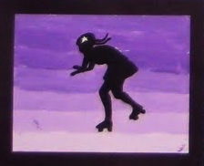
Today’s lesson -Color value using tints with silhouettes

Slide 11
Steps for the project:
Choose a distinct silhouette and trace the perimeter on the canvas/paper
Paint with white acrylic paint a white line the width of the paint brush around the perimeter line of the silhouette
Add a small amount of the color of acrylic paint you choose to the white paint and paint the next line around the same shape of the perimeter
Add additional colored paint to the bowl of white. You will continue to add more color each time before painting another line. This will gradually change the tint to a darker hue (color). The final color you paint will be the color with no white mixed in to get the darkest hue in the range you have created.
******Tip – only add a small amount of the color to the white paint each time so that it doesn’t get too dark too fast.
5) Progressively paint lines all the way to the edge of the paper.
After the paint dries, glue the silhouette to the canvas/paper within the lines you originally traced.
Option 2:
Paint the lines in a horizontal fashion across the canvas/paper.
Glue the silhouette to the middle of the canvas/paper (no need to pre – trace the silhouette in this version because it will be glued where ever you want after the paint dries.
Notes:
Supplies Needed:
Placemats for tables
Canvases (or paper)
Paintbrushes (approx. ¾ inch)
Disposable plates for mixing paint
Pallette knives (in ziplocs in the supply cabinet) or wood sticks for mixing
Acrylic paint (white for all and choice of colors for kids to pick one color – docents can distribute these while kids cut out silhouettes)
Water bowls
Soap for washing brushes (wash completely since acrylic paint dries like plastic and ruins brushes when not washed out wet. The same goes for clothes – if kids get it on clothes it will wash out while wet but becomes a permanent stain if dries)
Tacky glue
Scissors from kids’ desks
Sharpie to write name on back on frame part
T-shirt smocks ( in tub in tall docent supply closet)
Aprons for volunteers
Pre-printed silhouette images
Black paper if kids want to cut own images out

